Slide 1
The John Paul Experience
John Paul Pennisi
William Matrix Peckham
Chris Scarola
Thomas Beigner

Slide 2
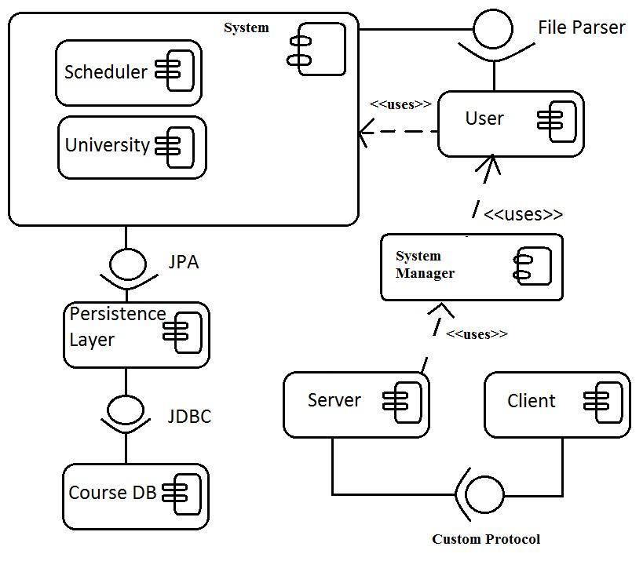
Components

Slide 3
Class Diagram

